Slide 1


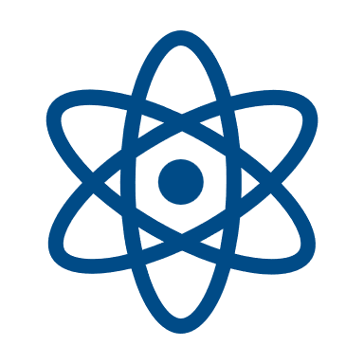
Nuclear Information and Records Management Association
Membership
As a NIRMA member, you will receive exclusive access to the full collection of our products and services. Membership includes access to technical guidelines and position papers, proceedings from prior conferences, monthly email or magazine informational articles, and access to our web. We have Business Units addressing technical publications, professional development, and membership needs. By joining, it gives you access to NIRMA's members all over the world.
Membership is granted by either registering for our Annual Symposium or by accessing our website at nirma.org. The annual individual NIRMA membership is $350.
Join NIRMA today!
Develop innovative skills and learn what other businesses are practicing. Grow alongside your peers in the nuclear industry as Information and Records Management Professionals.
SAVE THE DATE
Nuclear Information Management Symposium
50th Anniversary
July 27-29, 2026
Hotel Contessa
San Antonio, TX
Leading the Way in Nuclear Information Management -
Now and in the Future
NIRMA
Tri-fold
Rev 2 06.25
Contact Information
NIRMA Administrator
nirma@nirma.org
Go to nirma.org for Symposium updates and registration forms.
Leading the Way in Nuclear
Information and Records
Management – Now
And in the Future

Slide 2
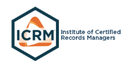
About NIRMA
Vision
To be the internationally recognized authority for Information and Records Management Professionals amongst regulated industries or agencies and their regulators.
Mission
To support regulated nuclear and selected industries, agencies, and their regulators in the development, implementation and administration of documents, records and information management processes to facilitate cost-effective operations and regulatory compliance.
Values
To promote professionalism, continuing education, accountability, teamwork, integrity, respect and excellence in all endeavors.
Professional Forum
NIRMA provides individuals and their organizations with real and timely opportunities to:
Influence industry direction and regulatory policy
Collaborate with industry peers on industry best practices
Contribute to resolution of emerging industry issues
Develop ANSI Standards and other technical and management guidance documents to address evolving challenges in today’s energy environment
Develop and train Information Management staff in Records Management, Document Control, and Information Management basics
In addition, individuals can assume leadership roles that support personal growth and development goals as well as provide direct benefit to their respective organizations.
Interfaces
NIRMA has developed advantageous
interfaces with several other professional organizations – in both the Nuclear and Information Management industries. A few examples of these relationships are listed below.
Nuclear Industry
ANSI – American National Standard Institute
ASME – American Society of Mechanical Engineers
IAEA – International Atomic Energy Agency
NEI - Nuclear Energy Institute
NITSL – Nuclear Information Technology Strategic Leadership
NRC - Nuclear Regulatory Commission
Information Management
AIIM
AFFIRM – Association for Federal Information Resources Management
ARMA International
CMBG – Configuration Management Benchmarking Group
EPRI – Electronic Power Research Institute
ICRM – Institute of Certified Records Managers
NARA – National Archives and Records Administration
The Nuclear Information and Records Management Association (NIRMA) is the nuclear industry’s leader in Information and Records Management. Since 1977, NIRMA has been uniquely qualified to provide guidance to commercial and Department of Energy facilities in the areas of quality records programs, regulatory compliance activities, electronic records initiatives, document management technologies, knowledge management issues, and industry benchmarking.
NIRMA is also a standards development organization, supporting the ANSI/NIRMA CM 1.0-2007 (R2021), Guidelines for Configuration Management for Nuclear Facilities.
NIRMA is a Not-For-Profit Corporation governed by a Board of Directors and has members from the U.S. as well as international communities. NIRMA provides information to its members through its website, educational webinars, Business Unit meetings and Annual Symposium.
Purpose
The primary purpose of the Membership and Marketing (M&M) Business Unit is to provide information on NIRMA to the current NIRMA membership as well as reach out to the nuclear industry in both private and government organizations, marketing and promoting the benefits of the NIRMA organization. Building the NIRMA organization by bringing on new members from every avenue making the NIRMA organization robust and diverse with the knowledge each member brings on board to share with the whole NIRMA organization.
Scope
To effectively provide good communication to NIRMA members on the news and information regarding the NIRMA organization, as well as marketing the NIRMA organization to the nuclear industry to build the membership and promote information management.
“NIRMA has something for everyone in our nuclear records industry. From plants to research facilities to government agencies to vendors and consultants, we all learn from one another.”
-Bruce Walters, CRM/NS
-Director, Records Management
-AECOM
Professional Certification
NIRMA has a professional alliance with the Institute of Certified Records Managers (ICRM) where advanced certification and recognition of Nuclear Information and Records Specialist (NS) is conferred for Certified Records Analysts and Certified Records Managers who meet the NS Qualifications.

