Slide 1
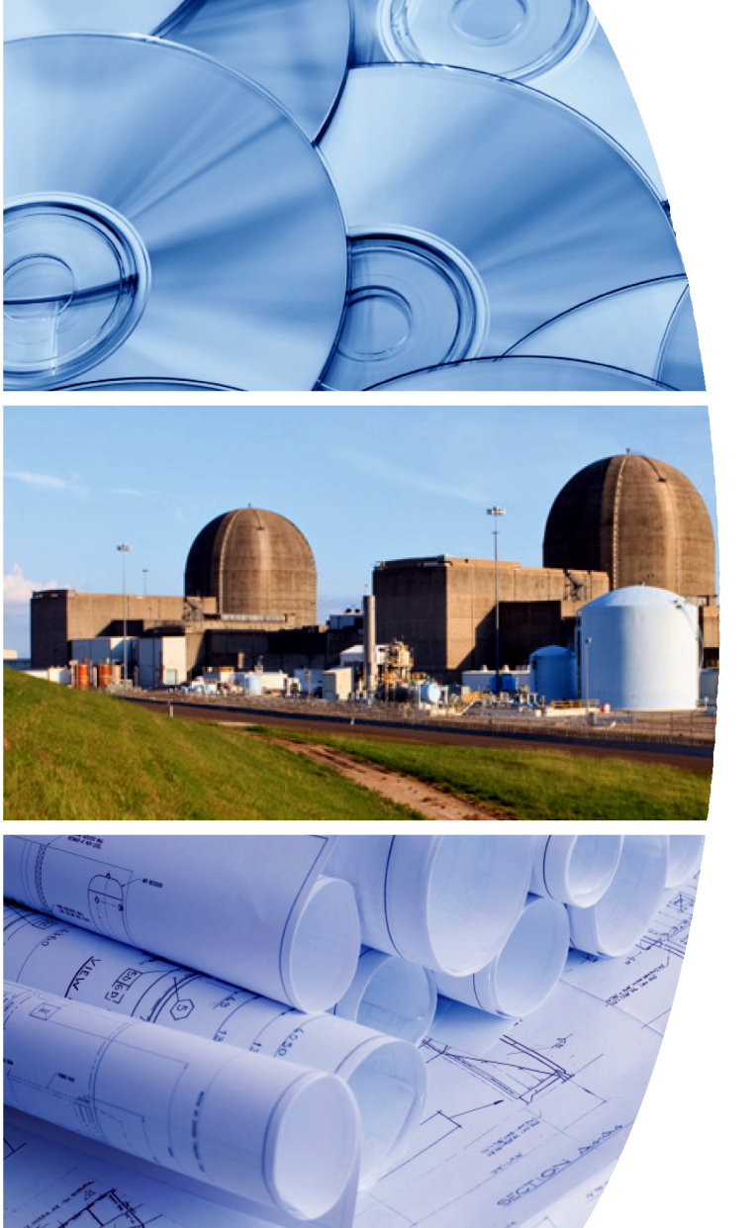
NIRMA
NIRMA
Membership
As a NIRMA member, you will receive exclusive access to the full collection of our products and services. Membership includes access to published technical guidelines and position papers, proceedings from prior conferences and webinar recordings, and access to do benchmarking surveys. We offer several means of soliciting support and information from NIRMA's members all over the world.
Membership is granted by either registering for our Annual Symposium or by accessing our website at nirma.org. The annual individual NIRMA membership is $325.
Join NIRMA today.
Develop innovative skills and learn what other businesses are practicing. Grow alongside your peers in the nuclear industry as Information and Records Management Professionals.
SAVE THE DATE
Nuclear Information
Management Conference
August 7-9, 2023
J W Marriott Resorts & Spa at Summerlin
Las Vegas, Nevada
NIRMA
nirma@nirma.org
Nuclear Information
and Records Management
Association
Contact information
NIRMA Administrator
nirma@nirma.org
Go to nirma.org for Conference updates and registration forms.
Leading the Way in Nuclear
Information and Records
Management – Now
And in the Future

Slide 2
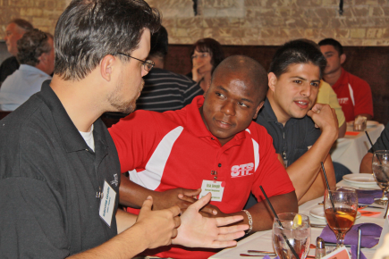
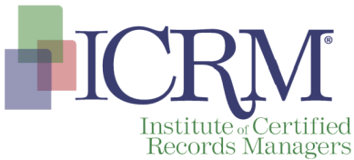
NIRMA
The Nuclear Information and Records Management Association (NIRMA) is the nuclear industry’s leader in Information and Records Management. Since 1977, NIRMA has been uniquely qualified to provide guidance to commercial and Department of Energy facilities in the areas of quality records programs, regulatory compliance activities, electronic records initiatives, document management technologies, knowledge management issues and industry benchmarking.
NIRMA is also a standards development organization, supporting the ANSI/NIRMA CM 1.0-2007 (R2021), Guidelines for Configuration Management for Nuclear Facilities.
NIRMA is a Not-For-Profit Corporation governed by a Board of Directors and has members from the U.S. as well as international communities. NIRMA provides information to its members through its website, educational webinars, Business Unit meetings and Annual Symposium.
“Networking at [the Annual NIRMA Conference] is the best of any professional conference I’ve attended... I plan to continue conversations with many of the people I’ve met and cannot wait to come back.”
-Chris Boudreaux
-Lead Network Administrator
-STP Nuclear Operating Co.
Vision
To be the internationally recognized authority for Information and Records Management Professionals amongst regulated industries or agencies and their regulators.
Mission
To support regulated nuclear and selected industries, agencies, and their regulators in the development, implementation and administration of documents, records and information management processes to facilitate cost-effective operations and regulatory compliance.
Values
To promote professionalism, continuing education, accountability, teamwork, integrity, respect and excellence in all endeavors.
Professional Forum
NIRMA provides individuals and their organizations with real and timely opportunities to:
Influence industry direction and regulatory policy
Collaborate with industry peers on industry best practices
Contribute to resolution of emerging industry issues
Develop ANSI Standards and other technical and management guidance documents to address evolving challenges in today’s energy environment
Develop and train Information Management staff in Records Management, Document Control, and Information Management basics.
In addition, individuals can assume leadership roles that support personal growth and development goals as well as provide direct benefit to their respective organizations.
Interfaces
NIRMA has
developed
advantageous
interfaces with several other professional organizations – in both the Nuclear and Information Management industries. A few examples of these relationships are listed below.
Nuclear Industry
ANSI – American National Standard Institute
ANI – American Nuclear Insurers
ASME – American Society of Mechanical Engineers
IAEA – International Atomic Energy Agency
NEI - Nuclear Energy Institute
NITSL – Nuclear Information Technology Strategic Leadership
NRC - Nuclear Regulatory Commission
PPA - Procedure Professionals Association
Information Management
ARMA International
CMBG – Configuration Management Benchmarking Group
EPRI – Electronic Power Research Institute
ICRM – Institute of Certified Records Managers
NARA – National Archives and Records Administration
Professional Certification
NIRMA has a professional alliance with the Institute of Certified Records Managers (ICRM) where advanced certification and recognition of Nuclear Information and Records Specialist (NS) is conferred for
Certified Records
Managers (CRM)
who meet the NS
Qualifications.

